Slide 1
Securing Linux Systems
Implement Cybersecurity Best Practices
Implement Identity and Access Management Methods
Configure SELinux or AppArmor
Configure Firewalls
Implement Logging Services
Back Up, Restore, and Verify Data

Slide 2

Topic A: Implement Cybersecurity Best Practices
Exam Objectives:
3.3 Summarize security best practices in a Linux environment.

Slide 3
Cybersecurity
The protection of computer systems and digital information from unauthorized access, attack, theft, or data damage.
Pivotal for all modern organizations.
Essential for individuals with digital identities.
Linux is subject to cybersecurity considerations.
All computer users are responsible for security.
Especially those with critical access.
Notes:
Teaching Tip: This lesson is not a deep dive into cybersecurity, and some advanced concepts are only briefly touched upon. As time permits, you may wish to go into more detail on any particular subject matter.

Slide 4
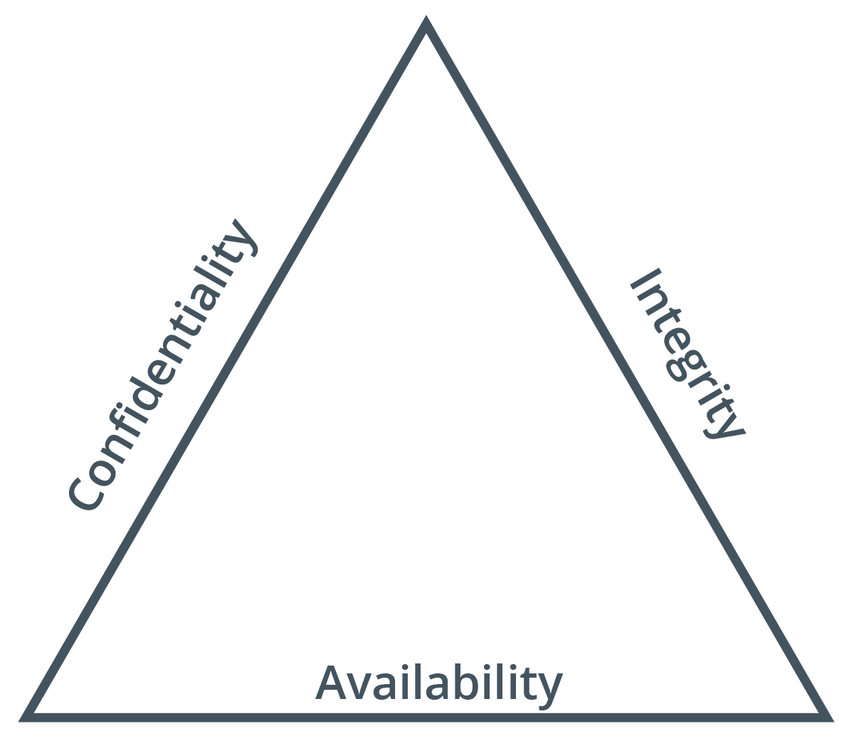
The CIA Triad
Principle | Description
Confidentiality | Keep information private and protected from unauthorized access. Controlled through encryption and access control.
Integrity | Keep information accurate and without unauthorized modification. Controlled through hashing, digital signatures, etc.
Availability | Systems operate continuously and are accessible to authorized users. Controlled through redundancy, fault tolerance, etc.

Slide 5
Authentication Methods
Authentication Method | Description
PINs/passwords/passphrases | Strings of text input along with user name. Meant to be memorized only by user they apply to.
Tokens/OTPs | Physical or digital unique object that you possess to verify identity. Can generate OTPs that expire and are not meant to be memorized.
Biometrics | Verify identity based on user's physical characteristics. Fingerprint scanners, iris scanners, voice recognition, etc.
RADIUS/TACACS+ | RADIUS provides AAA services to remote access clients. TACACS+ is more secure and scalable version.
LDAP | Directory service protocol that runs over TCP/IP networks. LDAPS uses SSL/TLS encryption for better security.
Kerberos | Centralized SSO method based on ticket-granting system. Can manage access control to many different services.

Slide 6
Multi-Factor Authentication (Slide 1 of 2)
The practice of requiring a user to present at least two different factors before the system authenticates them.
Factors are:
Something you know
Something you have
Something you are
Prevents unauthorized access if one factor is compromised.
Tokens/OTPs often used as second factor after password.
Biometrics used in more advanced systems as another factor.
Must be different factor, not method.
Hardware token + software token is not MFA (both something you have).

Slide 7
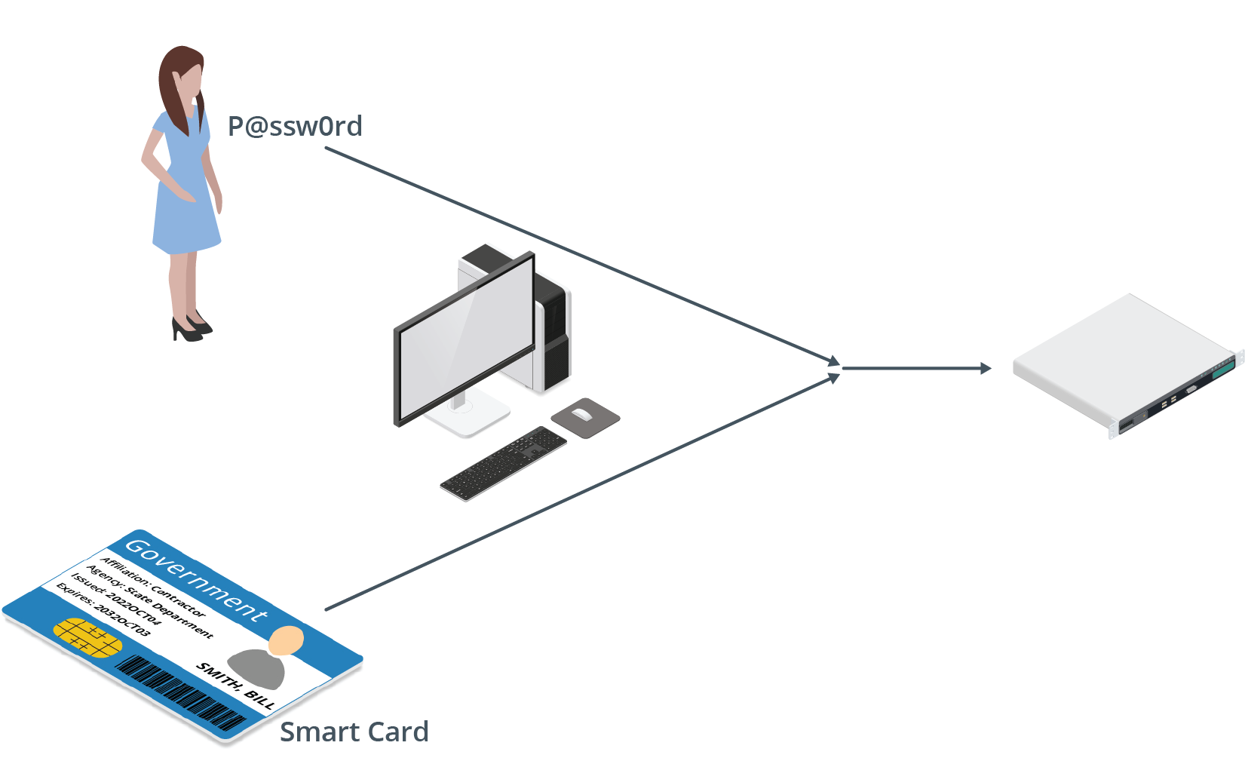
Multi-Factor Authentication (Slide 2 of 2)

Slide 8
Privilege Escalation
The act of a user obtaining access to additional resources or functionality that they are normally not allowed access to.
Example: Normal user exploits vulnerability to gain root privileges.
Can be used for legitimate purposes.
Admin using sudo
Look out for behavior that enables escalation for attackers.
One pitfall is overly permissive SUID/SGID.
Use principle of least privilege.
Avoid giving file same SUID/SGID as root.
Watch for back door programs.

Slide 9
chroot Jail (Slide 1 of 2)
A technique of controlling what a process can access on a file system by changing the root directory for the environment.
New root directory is called a "jail."
Process and children cannot "break out" of jail.
Process and children can't access other parts of file system.
Example: Change root to /home/user/
Process references root (/) but can only get to /home/user/
Separates privileged access on file system.
Malicious/rogue process can't damage files outside jail.
chroot command enables you to change root directory.
Example: chroot /home/user /usr/bin/bash

Slide 10
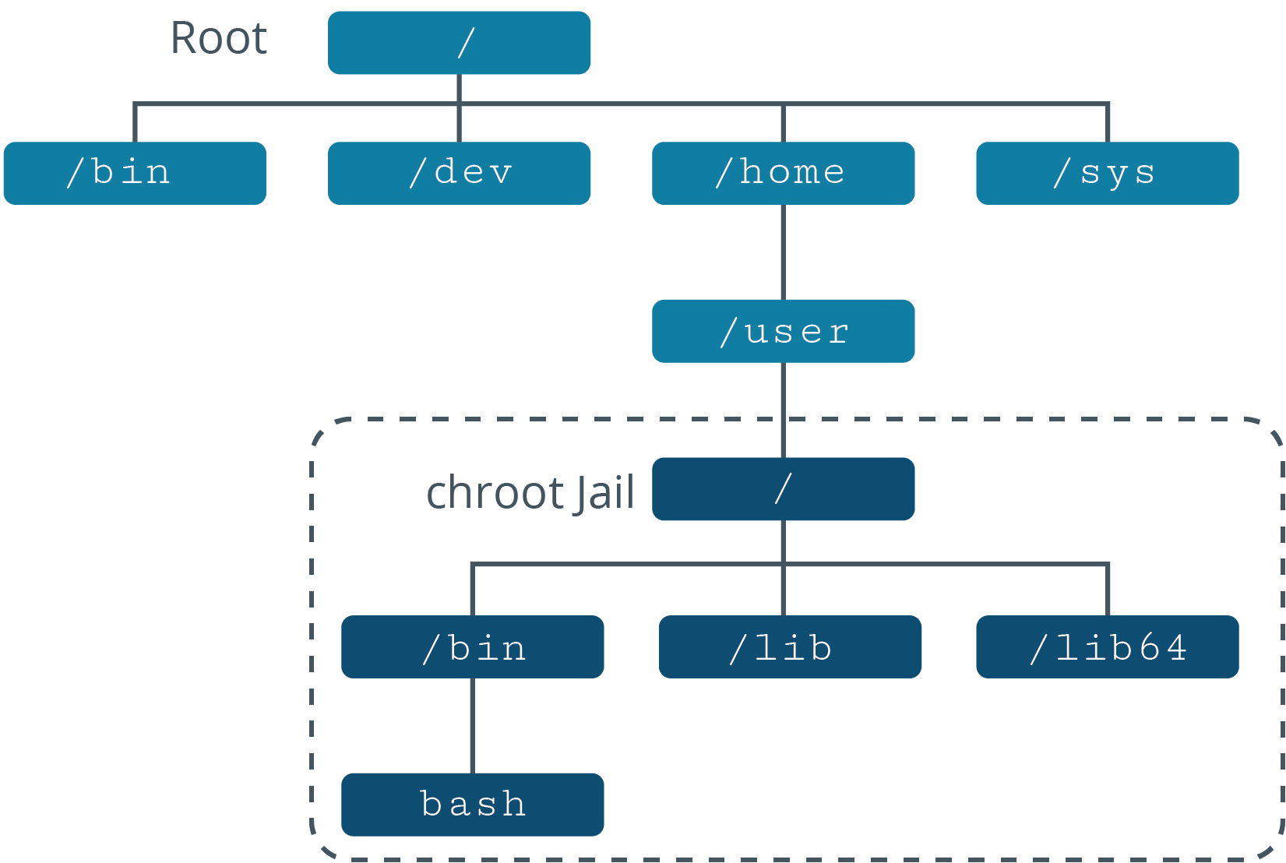
chroot Jail (Slide 2 of 2)

Slide 11
Encryption (Slide 1 of 2)
A cryptographic technique that converts data from plaintext form into coded, or ciphertext, form.
Decryption does the opposite.
Algorithm called a cipher is responsible for conversion process.
Only authorized parties with decryption info can read the data.
Info is called a key.
Key is used with cipher to make message unreadable without key.
A fundamental technique for upholding confidentiality.

Slide 12
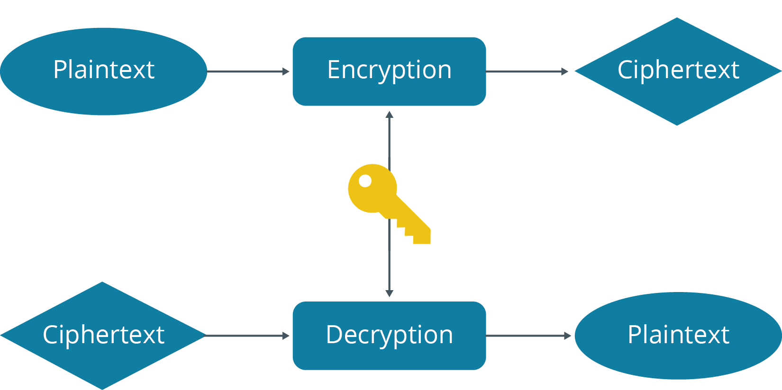
Encryption (Slide 2 of 2)

Slide 13
LUKS
A platform-independent FDE solution used to encrypt storage devices in a Linux environment.
Uses dm-crypt subsystem on Linux.
Maps encrypted devices to virtual device names.
Standardizes format of encrypted devices.
High degree of compatibility.

Slide 14
The cryptsetup Command (Slide 1 of 2)
Front-end to LUKS/dm-crypt.
LUKS Action | Used To
luksFormat | Format storage device using LUKS.
isLuks | Check if device is LUKS-formatted.
luksOpen | Open LUKS storage device for mapping.
luksClose | Remove LUKS storage device from mapping.
luksAddKey | Associate new key material with LUKS device.
luksDelKey | Remove key material from LUKS device.

Slide 15
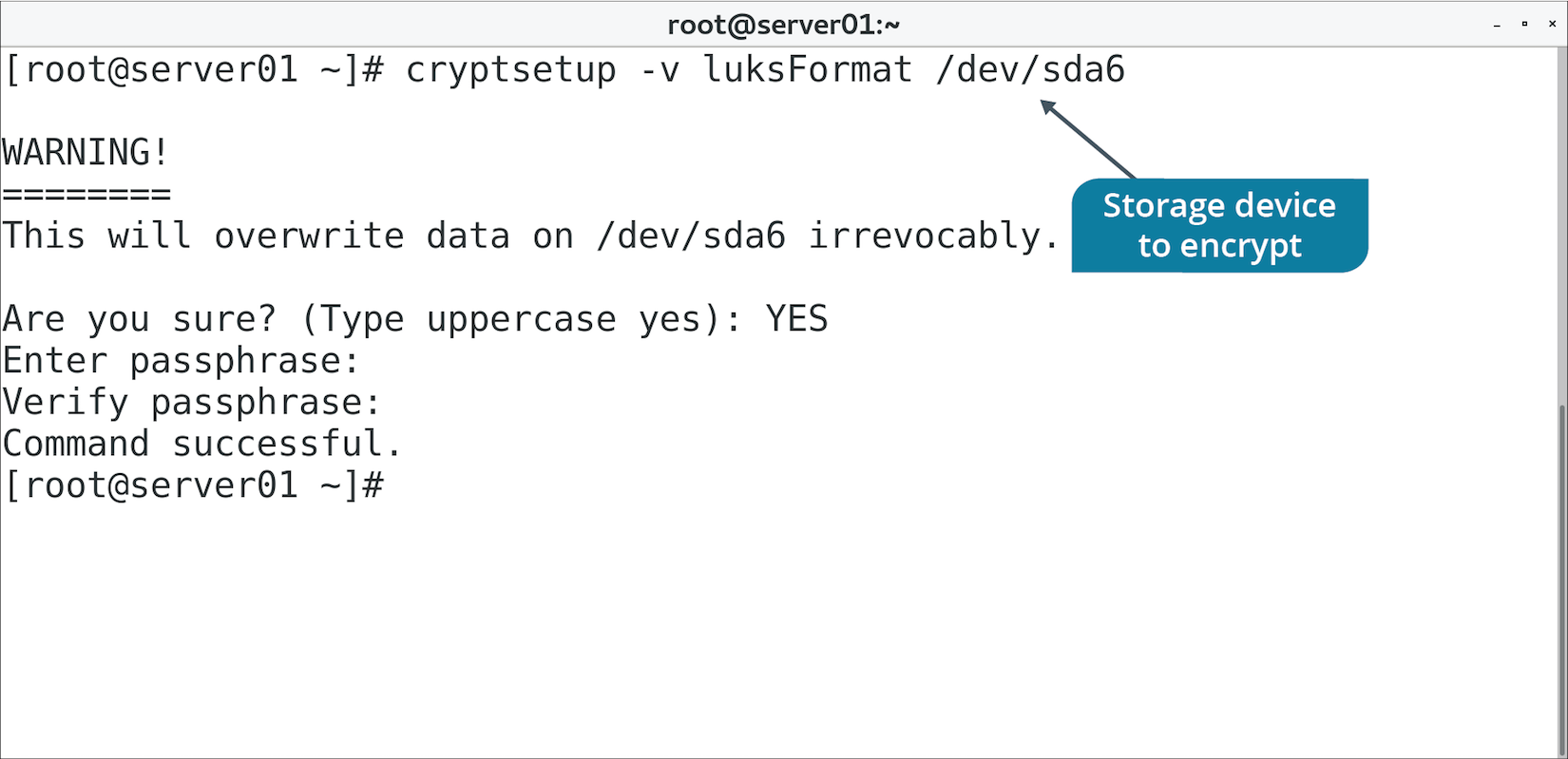
The cryptsetup Command (Slide 2 of 2)

Slide 16
Hashing (Slide 1 of 2)
A function that transforms plaintext input into an indecipherable fixed-length output.
Ensures process cannot be feasibly reversed.
Output is called a hash, hash value, or message digest.
Input length can vary, but hash is fixed.
Small change to input changes hash significantly.
Used in:
Password authentication.
Protecting integrity of messages.
Verification of file integrity after transfer.

Slide 17
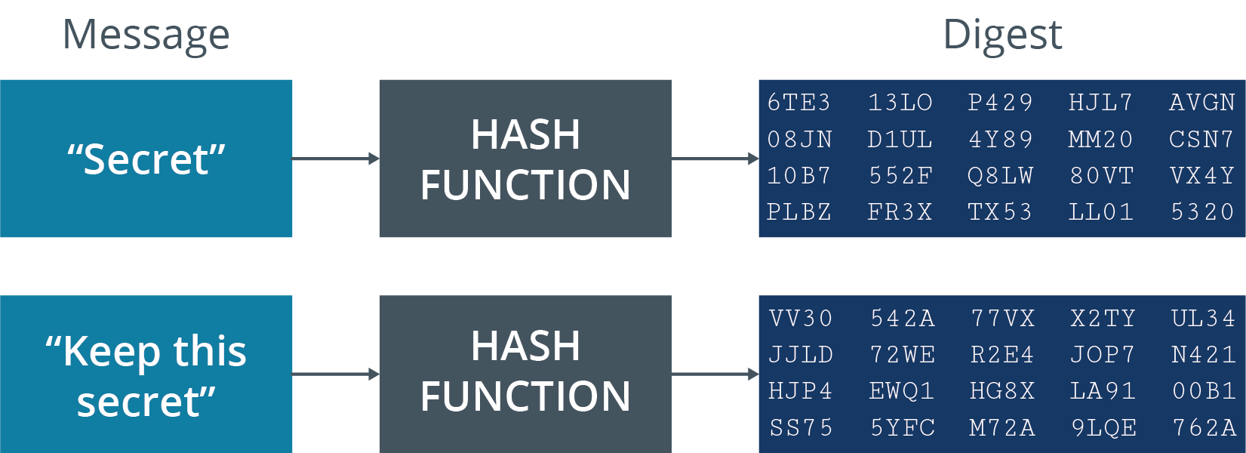
Hashing (Slide 2 of 2)

Slide 18
Networking Security Best Practices
Enable SSL/TLS in all web servers.
Configure SSH to disable root access.
Deny hosts that are not recognized.
Consider changing default port associations.
Notes:
Teaching Tip: Certificates and OpenSSL are discussed in the next topic.

Slide 19
User Access Security Best Practices
Protect boot loader with a password.
Protect BIOS/UEFI with password.
Discourage use of USB storage devices.
Ensure UIDs aren't being shared.
Consider leveraging a PKI for authentication.
Restrict access to cron.
Disable Ctrl+Alt+Del functionality.

Slide 20
Additional Security Best Practices
Enable auditd service.
Add banner message and MOTD to communicate expectations to users.
Separate OS data from other data on partitions/volumes.
Regularly monitor the CVE database.
Disable/uninstall unused/insecure services.

Slide 21
Guidelines for Implementing Cybersecurity Best Practices
Protect CIA of info.
Consider using advanced authentication methods.
Consider requiring MFA.
Don't grant more access than necessary using SUID/SGID.
Place unprivileged processes in chroot jails.
Encrypt sensitive data.
Use LUKS to fully encrypt storage device.
Implement networking best practices.
Implement user access best practices.
Implement additional best practices.

Slide 22
Discussing Cybersecurity Best Practices

Slide 23
Activity 12-1 Discussing Cybersecurity Best Practices
True or false? If one of the CIA triad principles is compromised, the security of the organization is threatened.
ANSWER:
True.

Slide 24
Activity 12-1 Discussing Cybersecurity Best Practices
Which authentication method would you use if you didn't want to issue hardware tokens, install special software, or require passwords of your users?
ANSWER:
Biometrics is one such authentication method. The user's physical characteristics, such as retina, fingerprint, or voice, are used in place of passwords, tokens, or specialized software.

Slide 25
Activity 12-1 Discussing Cybersecurity Best Practices
Why is multi-factor authentication effective in securing network and computing assets?
ANSWER:
Because it doesn't simply rely on one factor of authentication, but adds another external knowledge item, token, or attribute that is extremely difficult to counterfeit.

Slide 26
Activity 12-1 Discussing Cybersecurity Best Practices
What is the purpose of using a chroot jail?
ANSWER:
The chroot jail isolates or confines a process or program to its own directory structure. The process cannot live or access anything beyond the isolated chroot location (directory).

Slide 27
Activity 12-1 Discussing Cybersecurity Best Practices
Why is encryption essential to secure communications on a system or over the network?
ANSWER:
Because only someone or some process with the proper key can decrypt the information, which makes captured information useless to anyone without the proper key.

Slide 28
Activity: Encrypting a Volume
Backed up data is sensitive.
Data should not be readable to unauthorized users.
You'll encrypt volumes to protect confidentiality of data.
You'll start with the databk volume.
Without the key, users will only see ciphertext.
Won't be able to see plaintext of files.

Slide 29
Topic B: Implement Identity and Access Management Methods
Exam Objectives:
3.2 Given a scenario, configure and implement appropriate access and authentication methods.
4.3 Given a scenario, analyze and troubleshoot user issues.

Slide 30
Identity and Access Management
A process that provides identity, authentication, and authorization for entities in an environment.
Enables you to define attributes of identity.
Purpose, function, clearance, etc.
Enables access management systems to make informed decisions.
Allow vs. deny, what level of access, etc.
Example: Employee has identity in IAM system.
Role in company determines identity.
Crucial for provisioning and managing access in business environments.
Bolsters overall security.

Slide 31
SSH Authentication (Slide 1 of 2)
Default authentication in SSH uses passwords.
Susceptible to password attacks.
Attacker can guess or crack password.
Public-key cryptography is more secure.
User generates key pair (public key + private key).
Server has public key.
Server sends challenge that only private key can decrypt.
Can't be guessed/brute forced.
"Something you have" factor requires secure storage of private key.
Notes:
Teaching Tip: Some students may need a refresher on public-key cryptography.

Slide 32
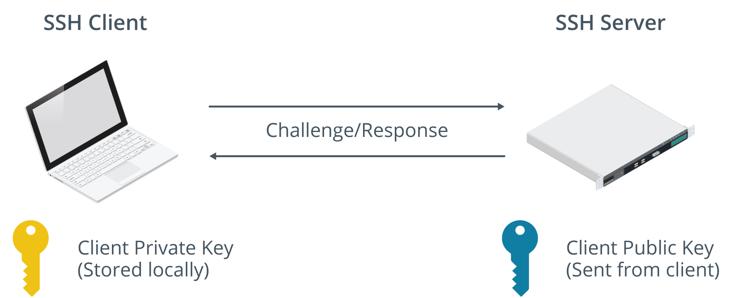
SSH Authentication (Slide 2 of 2)

Slide 33
SSH Authentication Files in Linux
~/.ssh/ —Contains key-related SSH files.
id_rsa —User's private key.
id_rsa.pub —User's public key.
authorized_keys —List of public keys the server accepts.
known_hosts —List of public keys the client accepts.
config —Used to configure misc. SSH connection settings.

Slide 34
SSH Key Commands (Slide 1 of 2)
Command | Used To
ssh-keygen | Generate key pair using specified algorithm.
ssh-copy-id | Append user's public keys to remote server's authorized_keys file.
ssh-add | Add private key identities to SSH key agent.

Slide 35
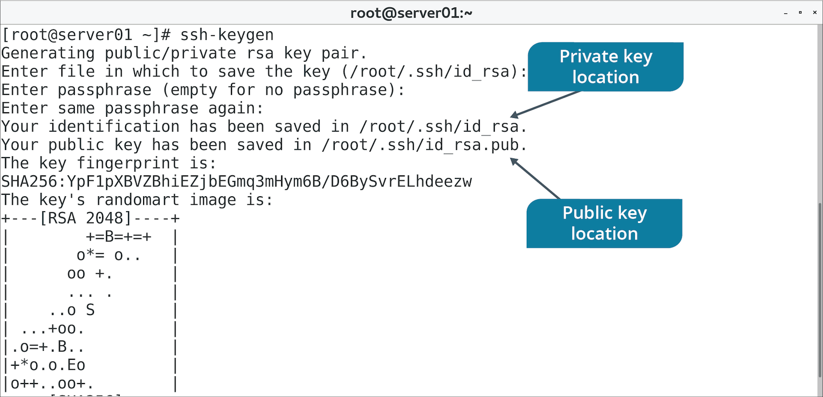
SSH Key Commands (Slide 2 of 2)

Slide 36
The sshd_config File
Setting | Used To
PasswordAuthentication | Enable/disable password authentication.
PubkeyAuthentication | Enable/disable public key authentication.
HostKey | Reference server's private keys.
UsePAM | Enable/disable PAM support.
Port | Change port SSH service binds to.
ListenAddress | Change IP address SSH service listens on.
SyslogFacility | Change logging level of SSH events.
ChrootDirectory | Reference a chroot jail path for a user.
AllowUsers, AllowGroups | Allow specified users/groups access over SSH.
DenyUsers, DenyGroups | Deny specified users/groups access over SSH.
PermitRootLogin | Enable/disable root login over SSH.

Slide 37
PAM
An underlying framework and centralized authentication method leveraged by other services and applications.
Used by services like Kerberos, LDAP, etc.
Provides common authentication for different apps/services.
Authentication is streamlined.
Makes it easier for admins to configure authentication policies.
Can configure them system-wide.
No need to configure distinct policies for each service.
Developers can create their own PAM modules.
Supports specific authentication/authorization functions within app.

Slide 38
PAM Configuration (Slide 1 of 2)
Files located in /etc/pam.d/
Each PAM-aware service has its own file.
Each file includes directives.
Directive format:
<module interface> <control flag> <module name> <module arguments>
Module interfaces define function of authentication/authorization.
Control flags indicate what to do upon success/failure.
Module name references specific module.
Arguments can be optionally passed in.

Slide 39
PAM Configuration (Slide 2 of 2)
Example password policy directive:
password required pam_cracklib.so retry=5
password pertains to changing passwords.
required means result of module must be successful.
pam_cracklib.so module checks password against dictionary.
retry=5 gives user five chances to fail.

Slide 40
TTY Security
Users can work with multiple controlling terminals (/dev/tty#).
Root user working with terminal can be a security risk.
Anyone with root access can issue any command.
/etc/securetty
Leveraged by PAM to determine root access to terminals.
If file does not exist, root can use any terminal.
If empty, root can use single user mode or certain programs.
You can add/remove tty# to give/remove root access to specific terminal.

Slide 41
PKI
A system composed of various cryptographic components that authenticate and validate data and entities.
Includes certificate authorities, certificates, software, services, etc.
Implement in various hierarchical structures.
Can be public or private.
Implements asymmetric cryptography.
Encrypts/decrypts network data.
Often used to secure transactions of Internet.

Slide 42
PKI Components (Slide 1 of 2)
PKI Component | Description
Digital signature | Message digest encrypted with private key. Encrypted hash is attached to message as signature.
Digital certificate | Fundamental component of PKI. Associates credentials with public key. Validates holder's identity through digital signatures. Distributes public key.
CA | Server that issues certificates and maintains keys. Signs certificates so clients can validate. Different than self-signed certs. Owned by same entity that signs them.
CSR | Message sent to CA when entity applies for a cert. Includes information that should go into cert.

Slide 43
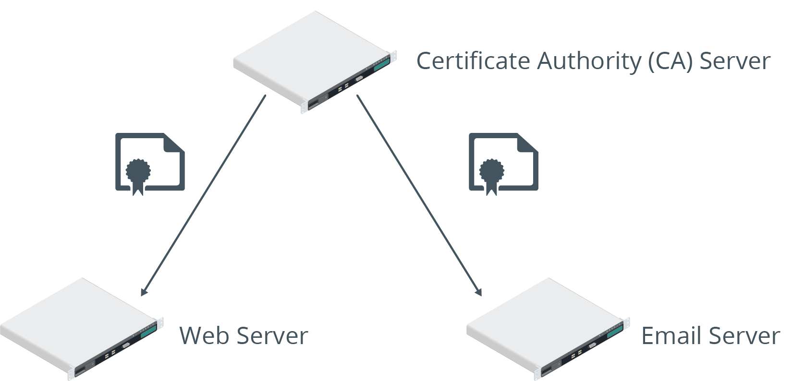
PKI Components (Slide 2 of 2)

Slide 44
OpenSSL
An open source implementation of SSL/TLS.
Secures data in transit using cryptography.
openssl command used to generate/manage PKI components.
Using openssl, you can:
Generate key pairs.
Generate self-signed certs.
Generate certs from CSRs.
Calculate hash values.
Encrypt/decrypt data.
Manage keys/certs in a CA.
And more.

Slide 45
VPNs and IPSec (Slide 1 of 2)
VPNs use tunneling protocols to authenticate clients and encrypt data.
IPSec is an open standard.
Usually used in site-to-site VPNs.
Provides authenticity, integrity, anti-replay, etc.
Operates at layer 3.
Two modes of operation:
Transport: Packet contents are encrypted, header is not.
Tunnel: Everything is encrypted.
Supported by many OSes and network devices.
Implementation differs.

Slide 46
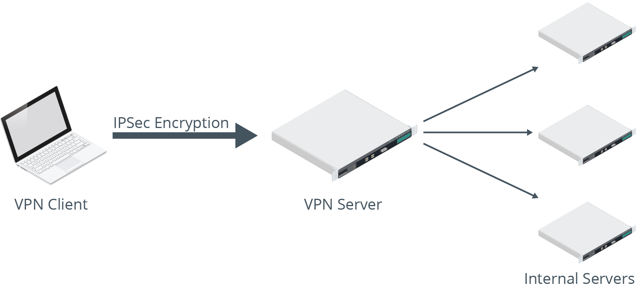
VPNs and IPSec (Slide 2 of 2)

Slide 47
VPNs and SSL/TLS
SSL/TLS also used as VPN tunneling protocol.
Usually in remote access connections.
Layer 7 protocol.
OpenVPN is a popular implementation.
Supports password, certificate, and smart card authentication.
Can generate self-signed certs or use CA-signed certs.
Available through openvpn package.
Config files stored in /etc/openvpn/

Slide 48
Access and Authentication Troubleshooting
Users may not be able to authenticate for remote access.
Ensure users have proper credentials and are transmitting them to server.
Example: SSH public-key authentication.
Make sure user has correct keys in correct place.
Make sure user system trusts the server.
Make sure user isn't violating policy.
Check local authentication to see if it's the source of the problem.
Example: Inactive account, password expiration, etc.
For Kerberos/RADIUS/TACACS+/etc.:
Ensure identities are configured properly.
Ensure authentication service is available over network.

Slide 49
Discussing IAM Methods

Slide 50
Activity 12-3: Discussing IAM Methods
You and the security team decide that, to enhance the security at Develetech, you need to use something more secure than passwords for your SSH sessions. What other authentication method can you employ to increase security?
ANSWER:
You can set up public-key cryptography.

Slide 51
Activity 12-3: Discussing IAM Methods
You notice several files in your home directory under the .ssh directory. One of them is id_rsa.pub. What is this file's purpose?
ANSWER:
The id_rsa.pub file contains your SSH public key.

Slide 52
Activity 12-3: Discussing IAM Methods
You want to set up SSH keys to better secure your SSH communications between your Linux desktop system and your Linux servers. Which command can you use to generate the public/private key pair?
ANSWER:
The ssh-keygen command generates the public/private key pair.

Slide 53
Activity 12-3: Discussing IAM Methods
OpenSSL is standard on Linux systems and is useful for securing data. What are some of its common uses?
ANSWER:
Common uses include: generating public and private keys; generating self-signed digital certificates in various formats; generating digital certificates for other entities based on CSRs; calculating hash values using various functions; encrypting and decrypting data using various algorithms; and managing keys and certificates in a CA.

Slide 54
Activity 12-3: Discussing IAM Methods
You need to set up a VPN so that your users can securely connect to the corporate network on public Wi-Fi connections, from home networks, and from any location where they have Internet access. Which software can you investigate that supports password, certificate, and smart card authentication methods?
ANSWER:
OpenVPN is a good choice for further investigation.

Slide 55
Activity: Configuring SSH Authentication Using a Key Pair
Admins need remote access to servers.
Servers already accept SSH connections.
Develetech has been a victim of brute force attacks.
Attackers have tried to gain remote access by trying passwords.
You'll change the authentication method used with SSH.
Each admin will use a cryptographic key pair to authenticate.
You'll also disable password authentication.
Notes:
Teaching Tip: Students may work with their partners from the previous activity, or you can assign them new partners. If there are an odd number of students in class, have one partner with you, the instructor.

Slide 56
Context-Based Permissions
A permissions scheme that uses multiple types of information about files/processes in combination to determine access.
Defines properties for files/processes.
Uses properties in conjunction to determine access.
Properties not used in isolation.
More advanced than default permissions scheme.
Two types of schemes in Linux:
SELinux
AppArmor

Slide 57
Topic C: Configure SELinux or AppArmor
Exam Objectives:
3.1 Given a scenario, apply or acquire the appropriate user and/or group permissions and ownership.
4.3 Given a scenario, analyze and troubleshoot user issues.
4.4 Given a scenario, analyze and troubleshoot application and hardware issues.

Slide 58
MAC
A model in which access is controlled by comparing an object's security designation and a subject's security clearance.
Objects like files are assigned labels.
Depending on sensitivity.
Subjects are assigned clearance levels.
Clearance levels must correspond to security levels.
Access granted if a match; denied if not.
Used by both SELinux and AppArmor.
Differs from default permissions model (DAC) in Linux.

Slide 59
SELinux
The default context-based permissions scheme provided with CentOS and Red Hat Enterprise Linux.
Optionally available for other distros.
Developed by NSA.
Provides security so unauthorized processes cannot:
Access or tamper with data.
Bypass security mechanisms.
Violate policies.
Execute untrustworthy programs.
Enforces MAC and enables classification of information.
Mitigates damage caused by malicious apps/users.

Slide 60
SELinux Contexts (Slide 1 of 2)
User:
What users can access object.
Not the same as Linux system user.
Linux system users are mapped to SELinux users.
Examples: unconfined_u, user_u, sysadm_u, root
Role:
What roles can access object.
SELinux users are authorized to be in roles.
Permit or deny access to domains.
object_r role applies to files/directories.
Type:
Label portion of MAC.
Groups objects with similar security requirements/characteristics.
ssh_t is domain for SSH process.

Slide 61
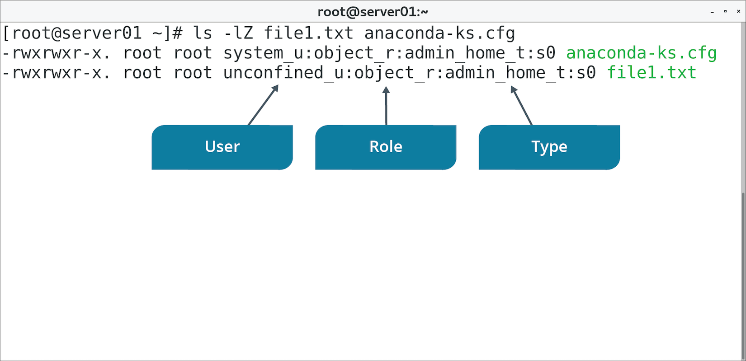
SELinux Contexts (Slide 2 of 2)

Slide 62
SELinux Modes
Mode | Description
Disabled | SELinux is off, and DAC will take over.
Enforcing | All SELinux policies are enforced and processes cannot violate them.
Permissive | SELinux is on, but policies are not enforced. Violations are logged rather than prevented.

Slide 63
SELinux Policies
Defines access parameters for system resources.
Allows or denies cross-domain/type access.
Files stored in /etc/selinux/
Can be configured by root.
Targeted policy:
All non-targeted subjects/objects run on DAC.
Targeted subjects/objects run on MAC.
Enabled by default.
Strict policy:
Every subject/object runs on MAC.

Slide 64
SELinux Commands (Slide 1 of 2)
Command | Used To
semanage | Configure SELinux policies.
sestatus | Get detailed status of SELinux.
getenforce | Display mode SELinux is running in.
setenforce | Change mode SELinux runs in.
getsebool | Display on/off status of SELinux boolean values.
setsebool | Change SELinux boolean values.
ls –Z | List security contexts of files/directories.
ps –Z | List security contexts of running processes.
chcon | Change security context of files.
restorecon | Restore default security context of files.

Slide 65
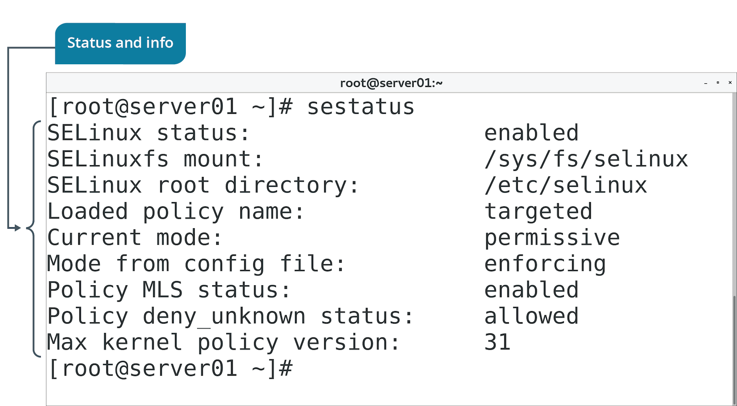
SELinux Commands (Slide 2 of 2)

Slide 66
SELinux Violations
Subject is denied access to an object based on policy.
Subject usually has insufficient privileges.
Violations are sometimes unexpected.
Diagnose issues with sealert command:
sealert -a /var/log/audit/audit.log
Displays all policy violations.
Displays detailed info about each violation.
Use audit2why to make output more human-friendly.
Explains why violation occurred.
Redirect entire log or grep single event and pipe it to command.

Slide 67
AppArmor
An alternative context-based permissions scheme and MAC implementation for Linux.
Packaged with Debian-based and SUSE Linux distros.
Provides same fundamental service as SELinux.
Has a different approach.
AppArmor is simplified, SELinux is complex.
AppArmor works with paths, SELinux references inodes.
Paths are referenced in configuration files (profiles).
Determine how to control access.
No types or domains, only profiles.

Slide 68
AppArmor Profiles
Executables have profiles located in /etc/apparmor.d/
Text files in path.binary format.
Example: /etc/apparmor.d/bin.dig
Capabilities provide executable with access to system functionality.
Example: net_bind_service enables binding well-known TCP/IP ports.
Path entries enable executable to access a file.
Specify permissions to grant to executable for file.
Read, write, execute, link, etc.

Slide 69
AppArmor Commands
Command | Used To
apparmor_status | Display status of AppArmor profiles.
aa-complain | Place profile in complain mode.
aa-enforce | Place profile in enforce mode.
aa-disable | Disable a profile, unloading it from kernel.
aa-unconfined | List processes with open network sockets that don't have a profile loaded.

Slide 70
Discussing SELinux and AppArmor

Slide 71
Activity 12-5: Discussing SELinux and AppArmor
You are in the testing phase of implementing some new services and SELinux keeps blocking external users from testing. How can you allow access without disabling SELinux or spending a lot of time setting up exceptions to allow all the ports required for testing?
ANSWER:
Place SELinux in permissive mode—this leaves policies in place, but they are not enforced. As violations occur, they are logged.

Slide 72
Activity 12-5: Discussing SELinux and AppArmor
You SSH into a Linux system that only allows SSH access. The system is a web server and you've checked to see everything is working properly. However, no one can connect to the web server with a web browser. You suspect SELinux is in enforcing mode and blocking access. How can you check?
ANSWER:
Run the sestatus command.

Slide 73
Activity 12-5: Discussing SELinux and AppArmor
You are researching a possible breach attempt on one of your SELinux-protected systems. Which command can you use to check the SELinux audit log?
ANSWER:
Either the sealert command or the audit2why command will provide you with results.

Slide 74
Activity 12-5: Discussing SELinux and AppArmor
You are deploying four Debian-based Linux servers and you do not want to use SELinux for access control. What is the most common alternative to SELinux for Debian-based systems?
ANSWER:
AppArmor is the most commonly used alternative to SELinux for Debian-based systems.

Slide 75
Activity 12-5: Discussing SELinux and AppArmor
You want to set some very restrictive protection on certain executables. AppArmor gives you that capability. Which mode do you use for the most restrictive profiles for your executables?
ANSWER:
Use enforce mode because it logs violations and prevents any violations from occurring.

Slide 76
Activity: Configuring SELinux
Team wants to move web server files to a different directory.
Server will run multiple web apps, each in a different path.
For now you'll move files to /var/develweb
SELinux stops the httpd service from reading files here.
You'll configure SELinux to allow access.

Slide 77
Topic D: Configure Firewalls
Exam Objectives:
3.5 Given a scenario, implement and configure Linux firewalls.
4.1 Given a scenario, analyze system properties and remediate accordingly.
4.4 Given a scenario, analyze and troubleshoot application and hardware issues.

Slide 78
Firewall (Slide 1 of 2)
A device that protects a system or a network from unauthorized access by blocking unwanted traffic.
Can allow or deny based on rules.
Rules can be configured by admins.
Usually have logging/alerting features.
Three generations:
Packet filters
Stateful firewalls
Application-layer firewalls

Slide 79
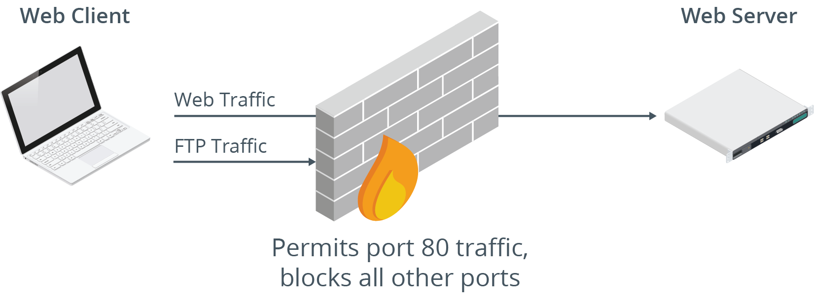
Firewall (Slide 2 of 2)

Slide 80
ACL Features
Allows or denies packets based on factors:
Source/destination IP address
Source/destination ports
Protocol
Example: Deny incoming traffic on port 21 (FTP).
Systems don't have an FTP server.
Performs actions:
Accept
Reject
Deny
Can also log actions with various details.

Slide 81
The iptables Tool (Slide 1 of 2)
Manages packet filtering and stateful firewall functionality.
Does this through tables.
Tables consist of rule sets called chains.
Packet is compared to first rule.
If no match, then moves on to next rule in chain.
If match, then moves on to next chain or is accepted, dropped, or returned.
Each table has built-in chains.
You can define your own.

Slide 82
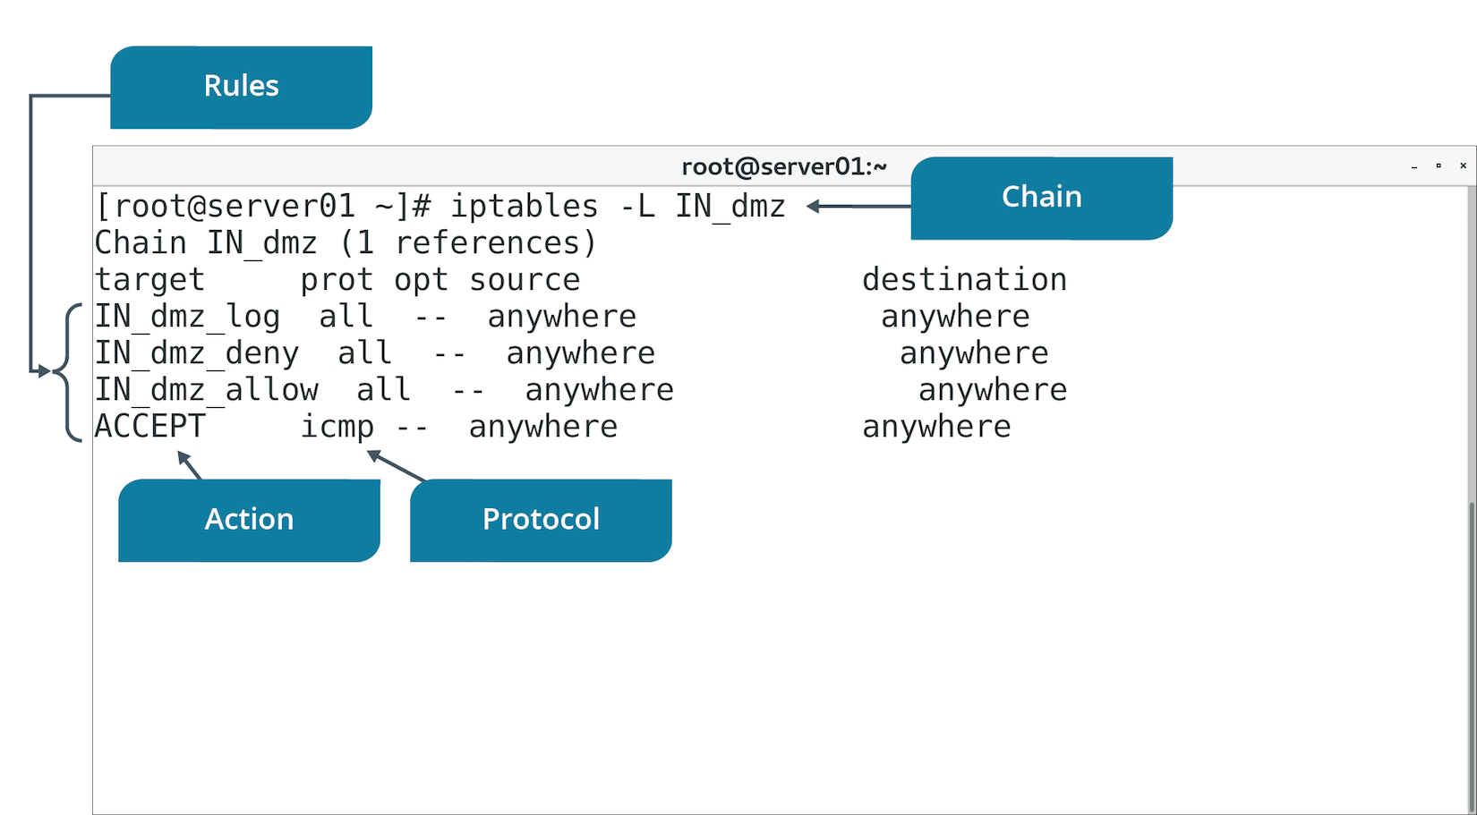
The iptables Tool (Slide 2 of 2)

Slide 83
UFW
A firewall management tool that makes it easier to configure the iptables service.
Originated with Ubuntu.
Primarily for home users without much firewall experience.
ufw command works with CLI.
Example:
ufw allow http/tcp
ufw logging on
ufw enable
Automatically configured as default deny.

Slide 84
The firewalld Service
Daemon used to manage a firewall dynamically.
Make changes without restarting.
Alternative to iptables
Firewall zones:
Apply to network resources.
Group resources together with similar security levels.
Range from least trusted to most trusted.
Firewall services:
Rules applying to specific services within a zone.
Example: Place HTTP service in dmz zone.

Slide 85
The firewall-cmd Command (Slide 1 of 2)
Enables configuration of firewalld
Query, add, modify, delete zones.
You'll use it regularly on RHEL-based distros.
firewalld is default.
Includes options to identify zone, configure interface, permit services, etc.

Slide 86
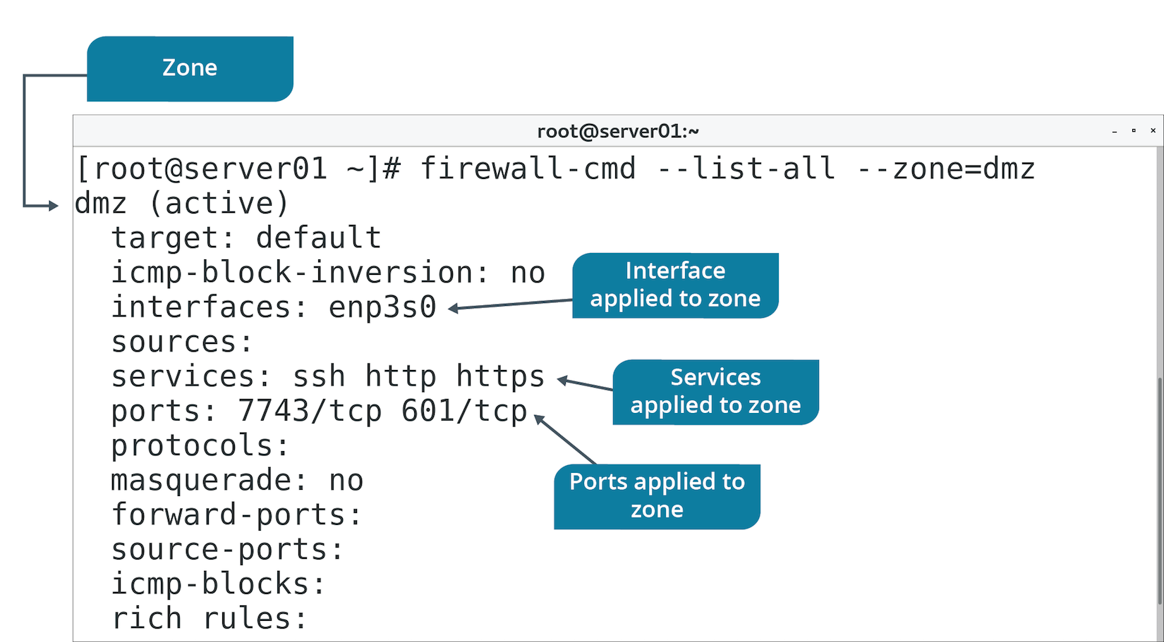
The firewall-cmd Command (Slide 2 of 2)

Slide 87
firewall-cmd Command Examples
firewall-cmd --get-zones
firewall-cmd --zone=dmz --list-all
firewall-cmd --zone=dmz --change-interface=<device ID>
firewall-cmd --zone=dmz --add-service=http
firewall-cmd --zone=dmz --add-port=21/tcp
firewall-cmd --zone=dmz --remove-service=http
firewall-cmd --zone=dmz --remove-port=21/tcp
firewall-cmd --reload

Slide 88
Netfilter
A Linux kernel framework that handles packets that traverse a network interface.
Provides packet filtering, NAT, connection tracking, etc.
Provides hooks into network stack.
Every packet is caught by hooks.
User space programs can register with hooks to interact with packets.
iptables is closely integrated with Netfilter.
Performs firewall actions because of hooks.
UFW and firewalld call iptables

Slide 89
IP Forwarding (Slide 1 of 2)
The Linux kernel implementation of networking routing.
Incoming traffic on one interface is forwarded to another interface.
Useful on routers/gateways that have multiple interfaces.
Used in conjunction with iptables:
One host is a router, the other is a web server.
Router has public interface and private interface; server has private.
Router forwards traffic to private interface only if it's on ports 80/443.
All other traffic is not forwarded.
Enable IPv4 forwarding:
echo 1 > /proc/sys/net/ipv4/ip_forward

Slide 90
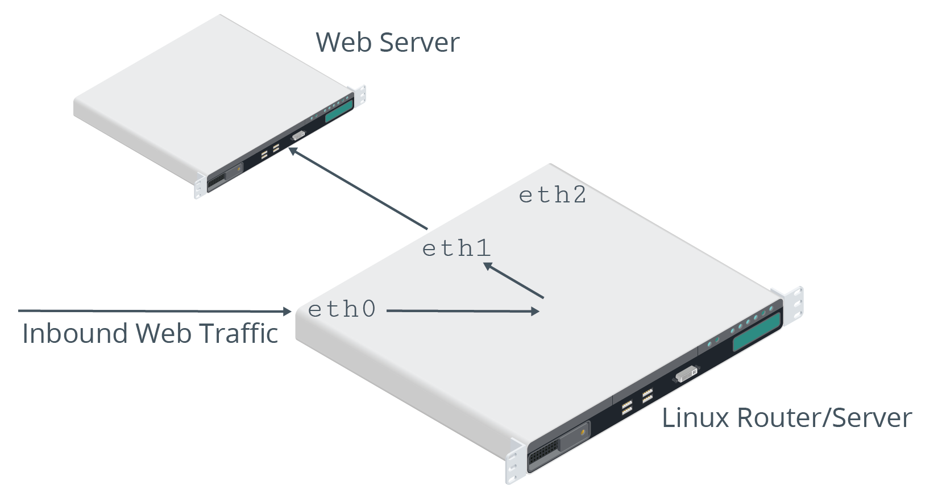
IP Forwarding (Slide 2 of 2)

Slide 91
IP Sets (Slide 1 of 2)
Stored collections of network identifiers.
IP addresses, ranges, MAC addresses, ports, interface names.
iptables can leverage IP sets for efficient rule matching.
Example: You want to drop traffic originating from several ranges.
Don't need to configure rules directly in iptables.
Create an IP set with ranges for iptables to reference.
Makes rule sets dynamic.

Slide 92
IP Sets (Slide 2 of 2)
Use ipset command to create/modify sets:
ipset create range_set hash:net
range_set is name.
hash is storage method.
net is data type.
Add ranges to set:
ipset add range_set 178.137.87.0/24
ipset add range_set 46.148.22.0/24
Add rule to iptables:
iptables -I INPUT -m set --match-set range_set src -j DROP

Slide 93
Firewall Configuration for Applications
Network apps require ports.
Custom apps may not have a standardized port.
Associate app with custom port in /etc/services
my-app 55111/tcp # My custom app
Will bind my-app to port 55111 and listen on that port.
Configure firewall to allow traffic using that port.

Slide 94
Firewall Troubleshooting
Common problem: Firewall blocks traffic it shouldn't.
Cause | Solution
Blocked ports | Check firewall rule set for overt port blocking for outgoing traffic. Create explicit allow rule for incoming traffic (default deny).
Blocked protocols | Ensure port is allowed on correct transport protocol (TCP/UDP). Ensure app-layer firewalls aren't blocking app-layer protocols (HTTP, FTP, etc.).
Restrictive ACLs | Consider that overly granular filtering might be unnecessary. Configure ACL rules to be straightforward. Don't write a granular rule for every possible scenario.

Slide 95
IPSs (Slide 1 of 2)
A security appliance that monitors and evaluates a system for signs of attacks in progress, and can actively block traffic.
Similar to firewalls.
Both stop unwanted traffic from entering network.
Key differences:
Firewalls trigger on predefined rules; IPSs monitor for anomalous behavior.
Firewalls are first layer of defense; IPSs are second layer.
Firewalls apply to incoming/outgoing traffic; IPSs apply to incoming.

Slide 96
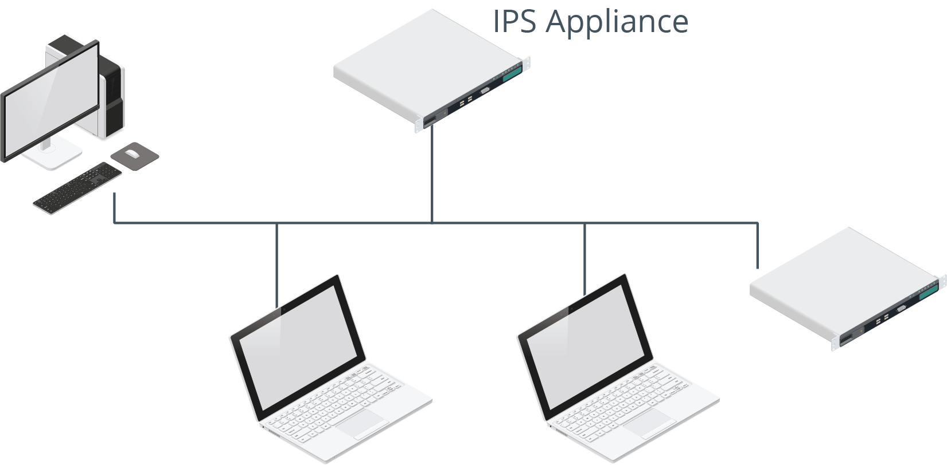
IPSs (Slide 2 of 2)

Slide 97
DenyHosts and Fail2ban
IPS solutions that monitor log files for anomalies.
DenyHosts:
Protects SSH servers from brute force attacks.
User attempts to repeatedly log in with different credentials.
Monitors authentication log for failed logins.
Multiple failures from same source IP will trigger block.
No IPv6 support.
Fail2ban:
Protects any service from brute force attacks.
Leverages Netfilter and iptables
Can update firewall rules.
Supports IPv4 and IPv6.

Slide 98
Discussing Firewalls

Slide 99
Activity 12-7: Discussing Firewalls
What type of firewall examines network packets in isolation, rather than in the context of other packets in a transmission?
ANSWER:
Stateless (packet filtering)

Slide 100
Activity 12-7: Discussing Firewalls
Several of your users want to install and use Linux at home but are confused by firewall rules and managing a firewall for themselves. What tool can you recommend to help them configure their firewalls?
ANSWER:
The Uncomplicated Firewall (UFW) is a tool primarily useful for home users who don't have the experience with the intricacies of firewall configuration.

Slide 101
Activity 12-7: Discussing Firewalls
True or false? The Uncomplicated Firewall (UFW) originated with Ubuntu but can be downloaded and installed on other distributions.
ANSWER:
True.

Slide 102
Activity 12-7: Discussing Firewalls
Your parent company purchased another smaller company that has six Linux systems in its server room, all of which are now your responsibility to manage. They all run the firewalld service. Which command can you use to manage the firewalld service and its associated zones?
ANSWER:
The firewall-cmd command enables you to configure firewalld by querying, adding, modifying, and deleting zones and services as desired.

Slide 103
Activity 12-7: Discussing Firewalls
True or false? IP forwarding is the Linux kernel implementation of network routing functionality.
ANSWER
True.

Slide 104
Activity: Configuring a Firewall
Network admins have designed a DMZ for public-facing systems.
Web servers in DMZ must allow access to HTTP/S.
Also must allow access to custom app on port 7743.
You need to tighten network security.
While maintaining availability for the necessary services.
You'll configure the firewalld service.
Default and preferred firewall for CentOS 7.

Slide 105
Topic E: Implement Logging Services
Exam Objectives:
3.4 Given a scenario, implement logging services.

Slide 106
System Logs
Record system activities tracked by syslogd
Uses syslog standard.
Facilitates centralized logging service over a network.
Supports remote and local logging.
Recorded in text files.
Examine and process like any other text file.
syslog entries include:
Date and time
Process name/ID
Message
Can also include facility and severity levels.

Slide 107
Log File Locations
Log File | Contains
/var/log/syslog | All system events except authentication messages (Debian).
/var/log/messages | General non-critical system events (RHEL).
/var/log/auth.log | Authentication messages (Debian).
/var/log/secure | Authentication messages (RHEL).
/var/log/kern.log | Kernel messages.
/var/log/[application] | Messages from miscellaneous applications.

Slide 108
Log Rotation
The practice of creating new versions of a log file to maintain a minimum log file size.
logrotate used to perform automatic rotation.
Adds .1 to end of file name.
Previous files are .2, .3, etc.
Can also append date to file name.
All versions are maintained unless specified otherwise.
Can be rotated daily, weekly, etc.
Can be rotated if file gets too big.
Benefits:
Easier to process/analyze smaller files.
Saves on space if older files are purged.

Slide 109
The rsyslogd Service
Makes improvements to older syslogd service.
Supports:
TCP for transport protocol.
SSL/TLS encryption.
Outputting to databases.
Local buffering.
Content-based filtering.
Maintains same basic config format.

Slide 110
The /etc/rsyslog.conf File (Slide 1 of 2)
Config file for rsyslogd service.
Determines how to handle syslog messages through rules.
Two-column format:
First column lists message facility and/or severity.
Second column lists associated action.
Actions:
What files to write message to.
What users to print message to.
What remote hosts to forward message to.

Slide 111
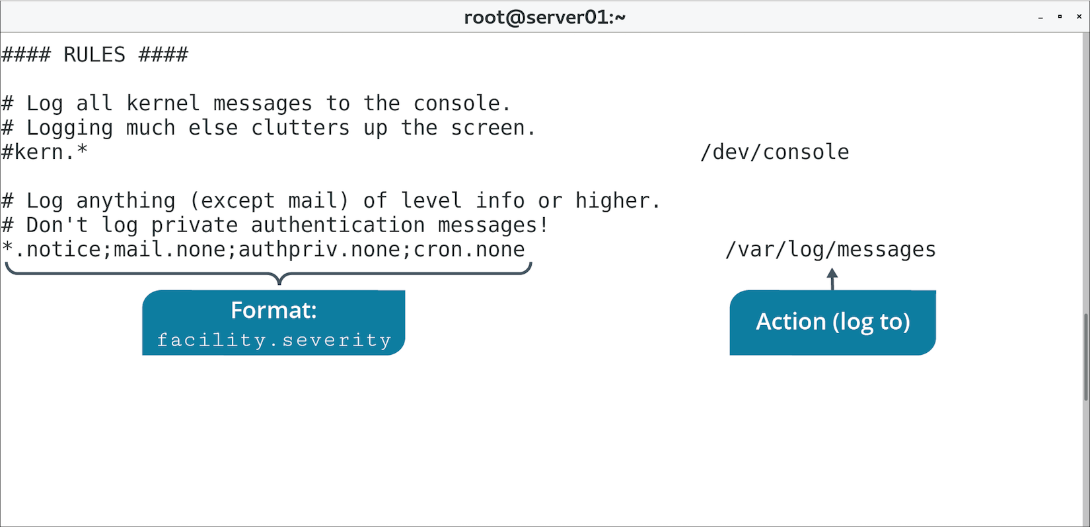
The /etc/rsyslog.conf File (Slide 2 of 2)

Slide 112
Third-Party Agents
Not all platforms support syslog.
Example: Windows uses Event Log standard.
Third-party agents facilitate integration.
Agents are software that act on behalf of other software.
Install syslog agent on platforms that don't normally support it.
Agent will depend on platform and type of service.
rsyslog and syslog-ng require different agents.
Agent will capture data in syslog format and send it to centralized server.

Slide 113
The journalctl Command (Slide 1 of 2)
View and query log files created by systemd journal.
Logs collected and stored via journald service.
journalctl can print entire log or can filter results.
journald often used with traditional syslog service.
Settings configured in /etc/systemd/journald.conf

Slide 114
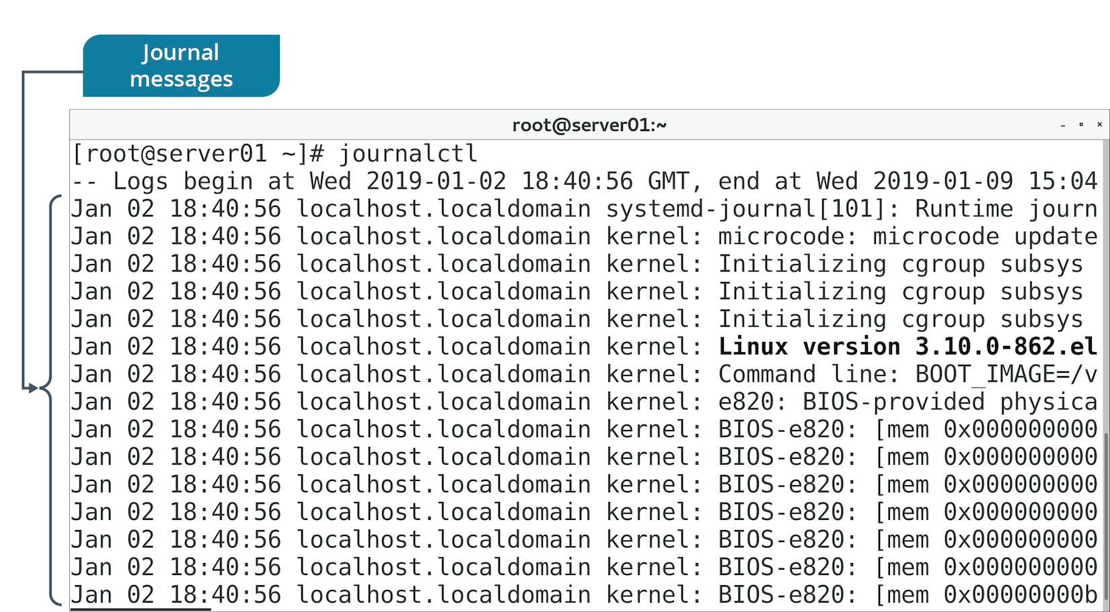
The journalctl Command (Slide 1 of 2)

Slide 115
The last Command (Slide 1 of 2)
Displays history of user login/logout events.
Includes date and time.
Includes terminal process.
Use options to filter results.
Retrieves info from /var/log/wtmp
lastb does the same but for failed attempts.
Retrieves info from /var/log/btmp

Slide 116
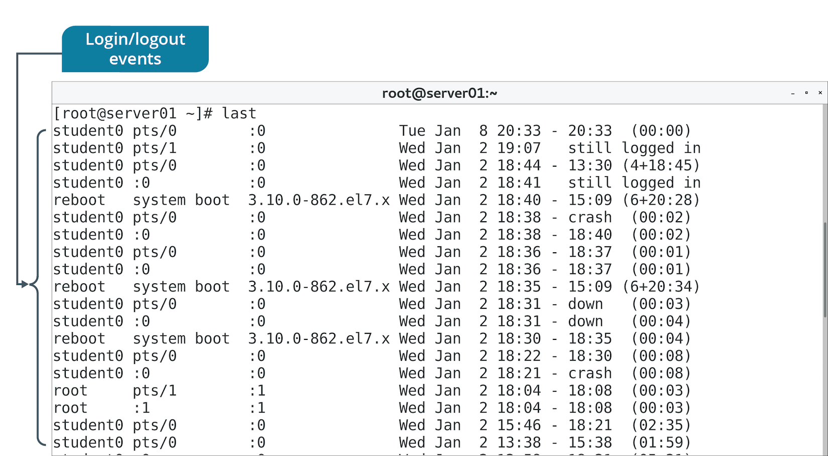
The last Command (Slide 2 of 2)

Slide 117
Discussing Logging Services

Slide 118
Activity 12-9: Discussing Logging Services
You have set up a training session for new Linux system administrators and you are discussing log files, their format, their location, and their contents. Generally speaking, where are most Linux system logs located?
ANSWER:
Linux system logs are located in the /var/log directory.

Slide 119
Activity 12-9: Discussing Logging Services
You are giving a presentation to the IT and Security teams to convince them that you should adopt a new corporate standard for syslog services on your Linux systems. Your argument is that rsyslogd has several advantages or improvements over the standard syslogd service. What are some of those improvements?
ANSWER:
Improvements include: TCP instead of UDP as the transport protocol; increasing the reliability of transmitted data; data encryption using SSL/TLS; outputting data to various database technologies like MySQL; buffering data on local systems when the remote receiver is not ready to accept it; filtering data based on content; and the rsyslogd log file format is backward compatible with the syslogd file format.

Slide 120
Activity 12-9: Discussing Logging Services
Some files were deleted from a shared directory after regular business hours last night and the other users want to know who was responsible for the deletions. To find out who was on the system during the suspected times, you use the last command. From which log file does the last command read its data?
ANSWER:
The last command retrieves information from the /var/log/wtmp file.

Slide 121
Activity 12-9: Discussing Logging Services
You suspect that some users have not logged into the file server to update their passwords since the new file server went into production. Which command lists all users and the last time they logged in?
ANSWER:
The lastlog command displays the list of users and the last time they logged into the system.

Slide 122
Activity 12-9: Discussing Logging Services
You need to set up a log rotation schedule that's relatively maintenance-free. In other words, you don't want to have to purge logs from 30 servers on a regular basis—you want it to happen automatically. Which utility provides this service on a schedule that you determine?
ANSWER:
The logrotate utility is used to perform automatic rotation of logs.

Slide 123
Activity: Configuring rsyslog for Local and Remote Logging
System should log only useful messages.
You'll fine-tune logs to be less noisy.
You also need to send authentication logs to a remote server.
You'll configure rsyslog for remote logging over the network.
Notes:
Teaching Tip: If students don't turn off remote logging, they may cause their partner's root partition to fill up with log data. Alternatively, you could have them remove the firewall rule and then restart the firewall service.

Slide 124
Activity: Examining Log Files
You've used some standard tools to view logs.
Now you'll use a tool like journalctl to perform more efficient filtering.
You can shape system messages for easier analysis.
You'll also get login event info using last and similar commands.
Notes:
Teaching Tip: Point out that this log also indicates if an account has never logged in.

Slide 125

Backup Types (Slide 1 of 2)
All files backed up.
High storage space and slow backup.
Quick to recover.

Slide 126
Topic F: Back Up, Restore, and Verify Data
Exam Objectives:
2.3 Given a scenario, create, modify, and redirect files.
2.6 Given a scenario, back up, restore, and compress files.

Slide 127
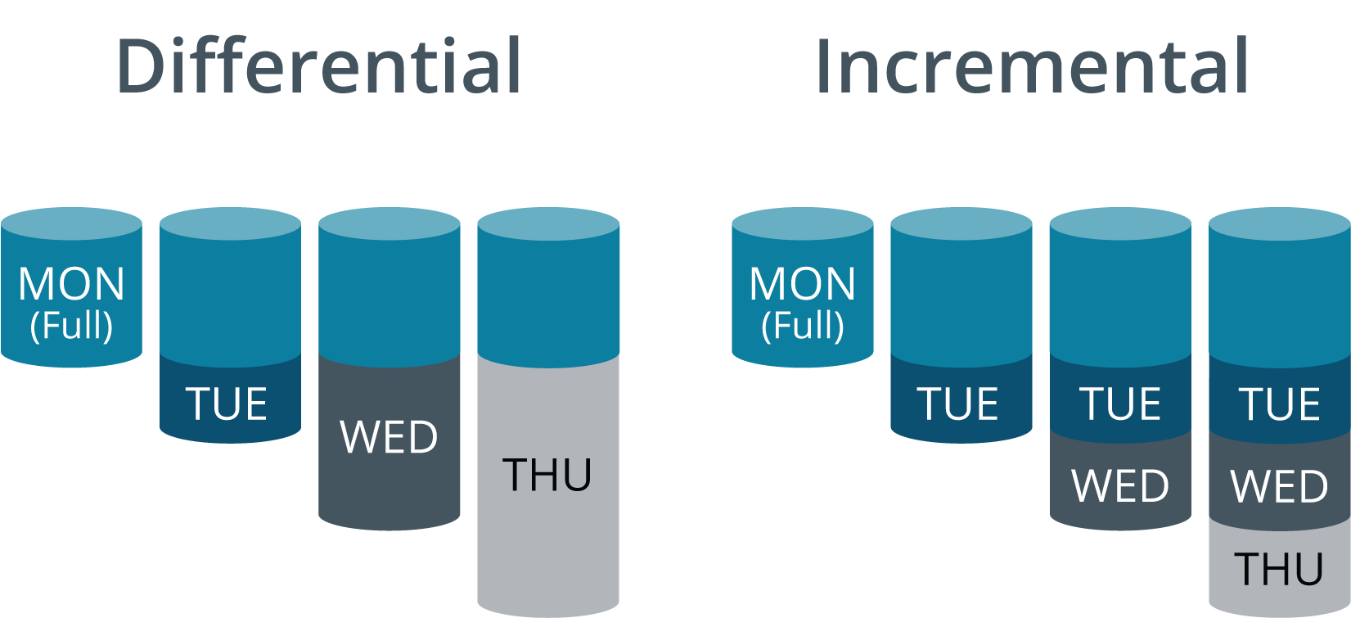
Backup Types (Slide 2 of 2)
All files that have changed since last full backup.
Less storage space and backup time than full.
Slower to recover.
All files that have changed since last backup (any).
Less time to perform than differential.
Slowest to recover.
Notes:
Teaching Tips: Depending on your preference, you may wish to teach all of the content in this topic first, then have students do all of the activities.

Slide 128
The tar Command (Slide 1 of 2)
Creates archives of data.
Usually created from directory that holds data you want to back up.
Can also be used on existing archives.
Extract files, store more files, update files, etc.
Archives have .tar extension.
Can also redirect/pipe output.

Slide 129
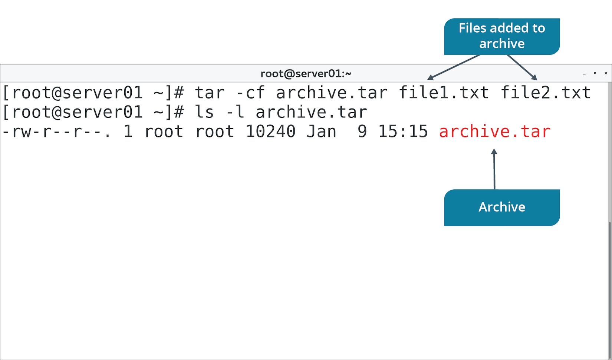
The tar Command (Slide 2 of 2)

Slide 130
The cpio Command
Operating Mode | Command | Used To
Copy-out | cpio –o | Copy files into an archive.
Copy-in | cpio -i | Copy files from an archive.
Copy-pass | cpio -p | Copy files from one directory tree to another.

Slide 131
The dd Command
Copies and converts files.
Enables transfer of files from one type of medium to another.
Operand | Used To
if={file name} | Specify file to read data from.
of={file name} | Specify file to write data to.
bs={bytes} | Specify number of bytes at which data is read/written.
count={blocks} | Specify number of blocks to write.
status={level} | Specify level of information to print to stderr.

Slide 132
The mirrorvg Command
Creates copies of all logical volumes in a logical volume group.
By default, creates mirrors on same drives as volume group.
You can specify other drives to mirror to.
You can create up to three copies using the -c option.

Slide 133
Off-Site Backup
A physical location outside of the main site that stores copies of data.
Key component of disaster recovery.
Reconstructs data after major disruption to main site.
Multiple ways to copy data from main to secondary site.
Physically move backup storage media.
Transfer files over a network.

Slide 134
Data Transfer Tools
Data Transfer Tool | Description
scp | Copy data to or from remote host over SSH. Data is encrypted in transit. scp file.txt user@host:/home/dir/
sftp | FTP that uses SSH tunnel as transport mechanism. Transfers files and manages directories. Interactive and non-interactive usage.
rsync | Transfers file differences, not all files. Efficient use of network bandwidth. Can use SSH or rsyncd daemon. rsync –a /home/mydir/ user@host:/home/mydir/

Slide 135
Activity: Archiving and Restoring Files
HR compiles employee data on a yearly basis into spreadsheets.
Spreadsheets contain personal info.
You need to store files in backup.
No need to regularly update files, so you'll archive them.
You'll test recovery should that be necessary in the future.

Slide 136
Activity: Synchronizing Files
R&D has prototype info that needs backing up.
Info includes model numbers, pricing, and release dates.
Files need to be updated regularly.
Backup copies should align with source copies.
You'll synchronize the copies to ensure changes when necessary.

Slide 137
Compression
A procedure in which data is encoded to reduce the amount of bits that are used to represent that data.
Process can significantly reduce file size.
Makes storage and transfer of data more efficient.
Compressed data is either lossless or lossy.
Used to reduce storage/transmission burden of backups.
Compress data before backing it up.

Slide 138
The gzip Command (Slide 1 of 2)
Used to compress/decompress .gz files.
Option | Used To
-d | Decompress files.
-f | Force compression/decompression.
-n | Omit saving original file name/timestamp.
-N | Save original file name/timestamp.
-q | Suppress all warnings.
-r | Enable directory recursion.
-v | Display name and percentage reduction of file.
-t | Perform an integrity check on file.

Slide 139
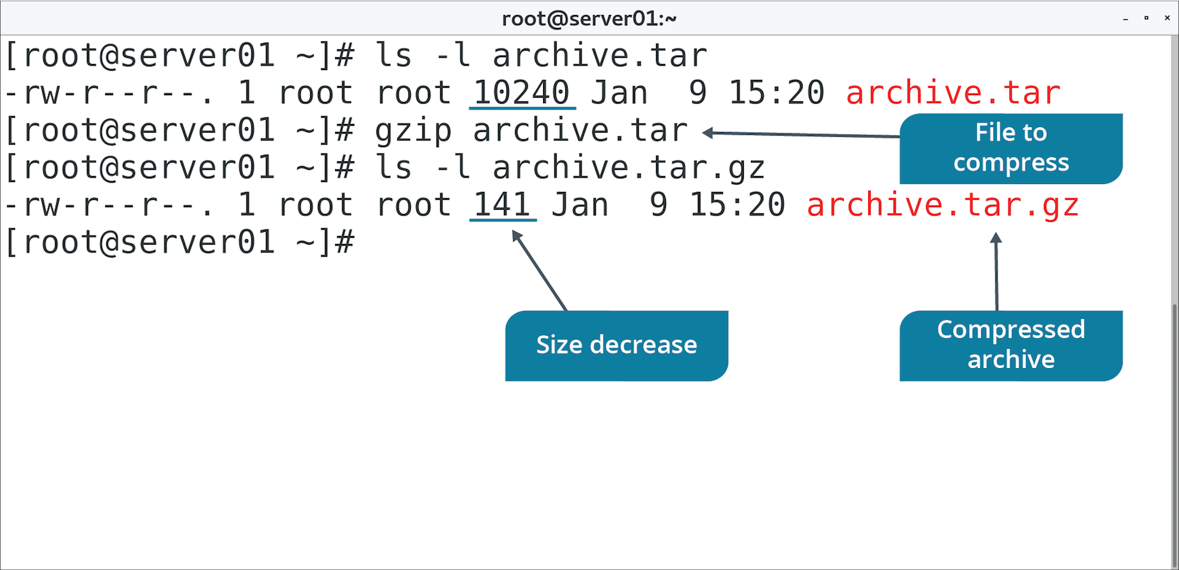
The gzip Command (Slide 2 of 2)

Slide 140
The xz Command (Slide 1 of 2)
Similar in function to gzip, but works with .xz files.
Option | Used To
-d | Decompress files.
-f | Force compression/decompression.
-q | Suppress all warnings.
-v | Display name and percentage reduction of file.
-t | Perform an integrity check on file.

Slide 141

The xz Command (Slide 2 of 2)

Slide 142
The bzip2 Suite (Slide 1 of 2)
Multiple commands for managing compression.
Command | Used To
bzip2 | Compress files.
bunzip2 | Decompress files.
bzcat | Decompress files to stdout.
bzdiff | Run diff on compress files.
bzip2recover | Recover data from damaged .bz2 files.
bzless | Run less command on compress files.
bzmore | Run more command on compressed files.

Slide 143

The bzip2 Suite (Slide 2 of 2)

Slide 144
The zip Command
Performs both compression and archiving.
Option | Used To
-d | Delete entries in archive.
-e | Encrypt archive contents.
-F | Fix a corrupted archive.
-r | Enable recursion.
-T | Perform an integrity check on file.

Slide 145
Which Compression Method Should You Choose?
Decision must be based on your own needs.
Important factors are speed and ratio.
Tests have been conducted.
Recommendations:
gzip when time is the biggest factor.
xz when storage space is the biggest factor.
bzip2 to strike a balance.

Slide 146
Activity: Compressing Files
Archives take up just as much data as the files they hold.
This is a waste of space.
You'll compress the archives to take up less space without losing data.
You'll try several compression algorithms and compare them.

Slide 147
Integrity Checking
The process of verifying that data has not been modified, whether intentionally or unintentionally, in any way.
Validates integrity.
Perform integrity checking after compiling backups.
Confirm data hasn't changed.
Avoid storing corrupted archives.
Several methods enable integrity checking.
Hashing is common.
Compare hashes to past values.
No change in hash means no change in data.

Slide 148
Hash Functions
An algorithm that performs a hashing operation.
Different kinds with different security levels.
MD5:
128-bit digest.
In public domain.
Insecure and discouraged from use with sensitive operations.
Still used in integrity checking.
SHA:
Modeled after MD5.
More secure.
SHA-1, SHA-256, SHA-384, SHA-512.
SHA-1 is deprecated.

Slide 149
The md5sum Command
Calculates hash value of file/stdin using MD5.
Use -c option for checking.
Specify file of file names and associated hashes.
Calculates file hashes and compares them to listed hashes.
For each file: pass, fail, or cannot find.
128-bit hash (32 characters in hex).
"Linux" string hash:
edc9f0a5a5d57797bf68e37364743831

Slide 150
SHA Commands (Slide 1 of 2)
Multiple commands used to calculate SHA values.
All functionally identical to md5sum
Differ based on bit size:
sha1sum
sha256sum
sha384sum
sha512sum

Slide 151
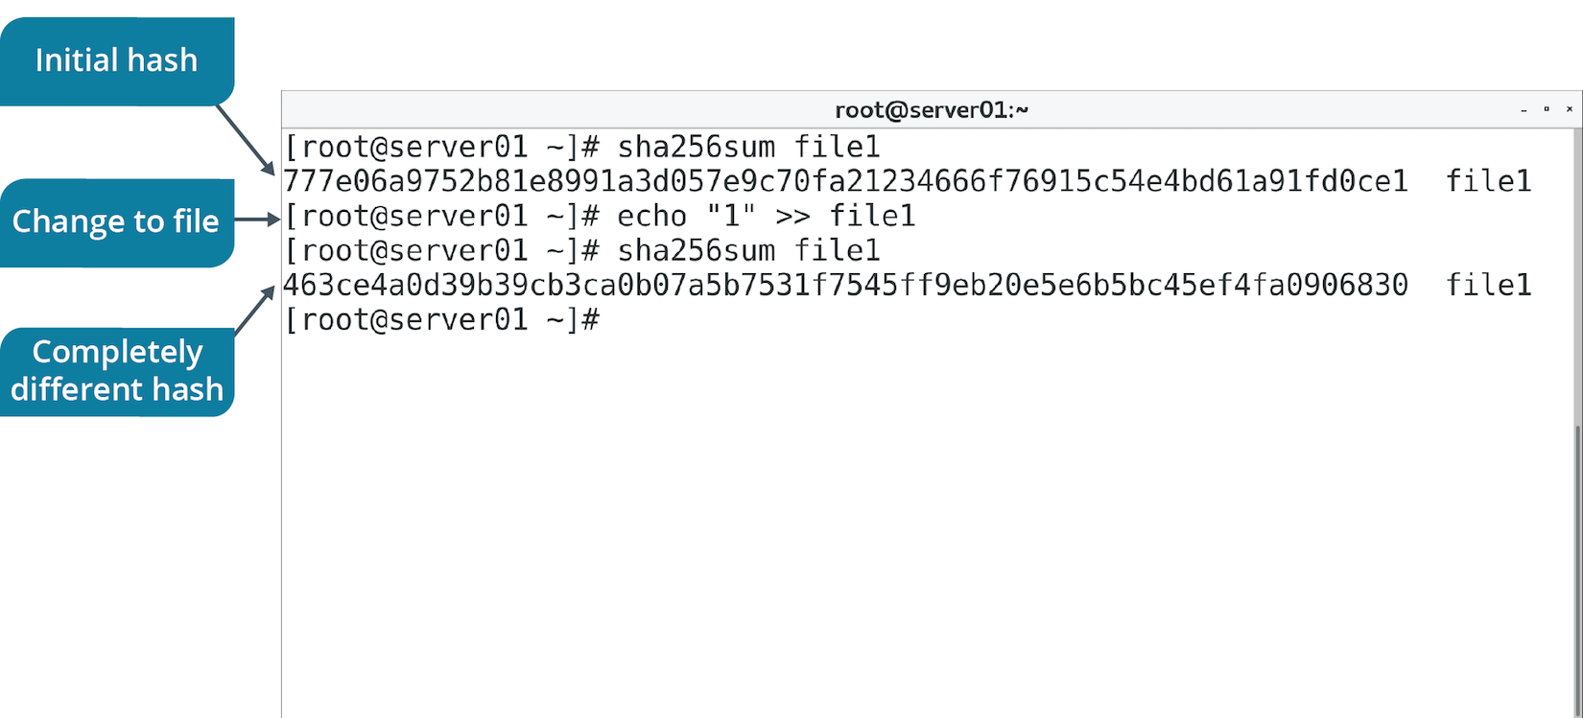
SHA Commands (Slide 2 of 2)

Slide 152
Discussing Backing Up, Restoring, and Verifying Data

Slide 153
Activity 12-15: Discussing Backing Up, Restoring, and Verifying Data
You and your team have devised a backup plan that includes a full backup once a month and then incremental backups between full backups. What are the two primary advantages of this backup scheme?
ANSWER:
It takes less time to perform incremental backups and it requires less space for the backups.

Slide 154
Activity 12-15: Discussing Backing Up, Restoring, and Verifying Data
Your team determines that for certain systems, snapshots are the appropriate backup method for critical storage contents. What is the advantage of a snapshot?
ANSWER:
Snapshots can be taken as checkpoints that you can restore to a particular point in time if required.

Slide 155
Activity 12-15: Discussing Backing Up, Restoring, and Verifying Data
What is the advantage of using an off-site backup and how can you transfer files from the main site to an off-site facility?
ANSWER:
The advantage is that, in case of a disaster, the data at the off-site facility is probably safe. You can transfer the files by VPN or by using physical media.

Slide 156
Activity 12-15: Discussing Backing Up, Restoring, and Verifying Data
There are several automated processes that copy files between servers for backups. These processes use the standard File Transfer Protocol (FTP). What is wrong about using FTP, and what is the better alternative?
ANSWER:
FTP data is transferred in plaintext (no encryption). The better alternative is Secure File Transfer Protocol (SFTP), which is encrypted.

Slide 157
Activity 12-15: Discussing Backing Up, Restoring, and Verifying Data
A senior-level administrator performed an audit on your backups and commended you for using SFTP to encrypt data as it traverses the network and the Internet. However, he introduces you to a new command, rsync, that has a particularly interesting advantage over SFTP. What is that advantage?
ANSWER:
The rsync command can copy files over SSH, but it also synchronizes (copies differences between) files, rather than copying the entire contents of a directory. Therefore, it saves network bandwidth.

Slide 158
Activity: Performing Integrity Checks on Files
Unauthorized users might tamper with prototype data.
Data can also become corrupted without it being obvious.
You'll run files through hash function.
You'll compare those hashes to hashes at a different time.
If they match, you can rest easy.
If they don't, something went wrong.

Slide 159
Do you plan to leverage a context-based permissions scheme like SELinux or AppArmor on your Linux systems? Why or why not?
Does your organization have off-site backups of critical data? If so, how does your organization conduct these backups? If not, do you think it's worth the effort?

